Slide 1
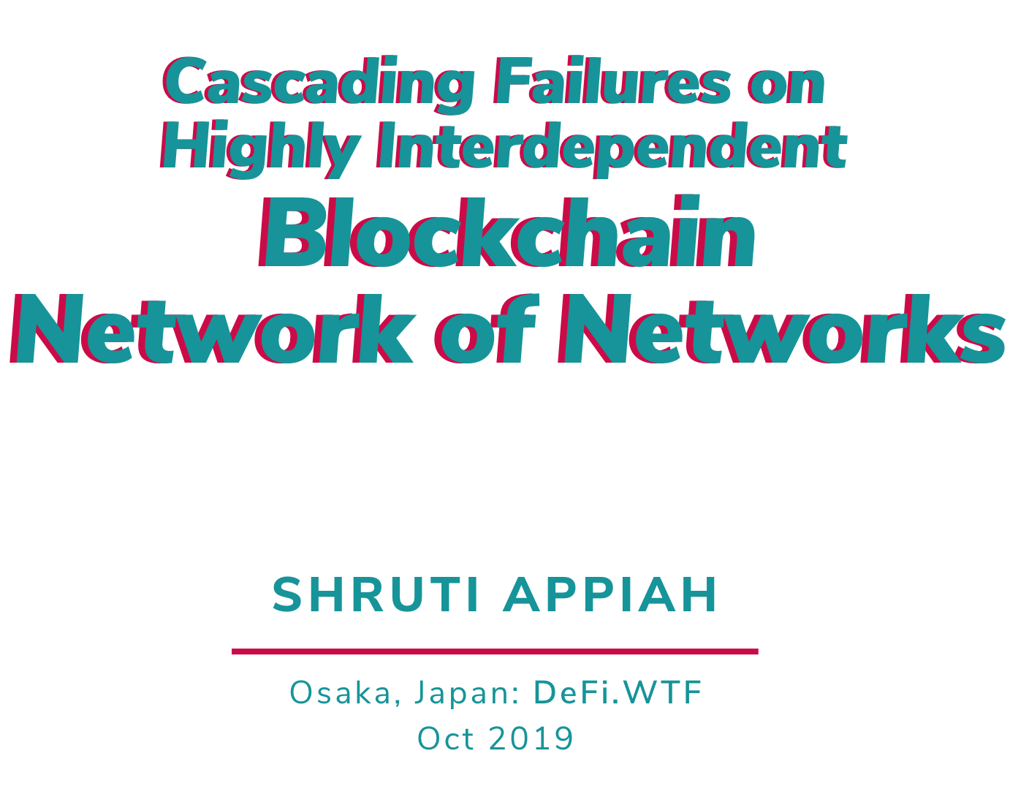

Slide 2



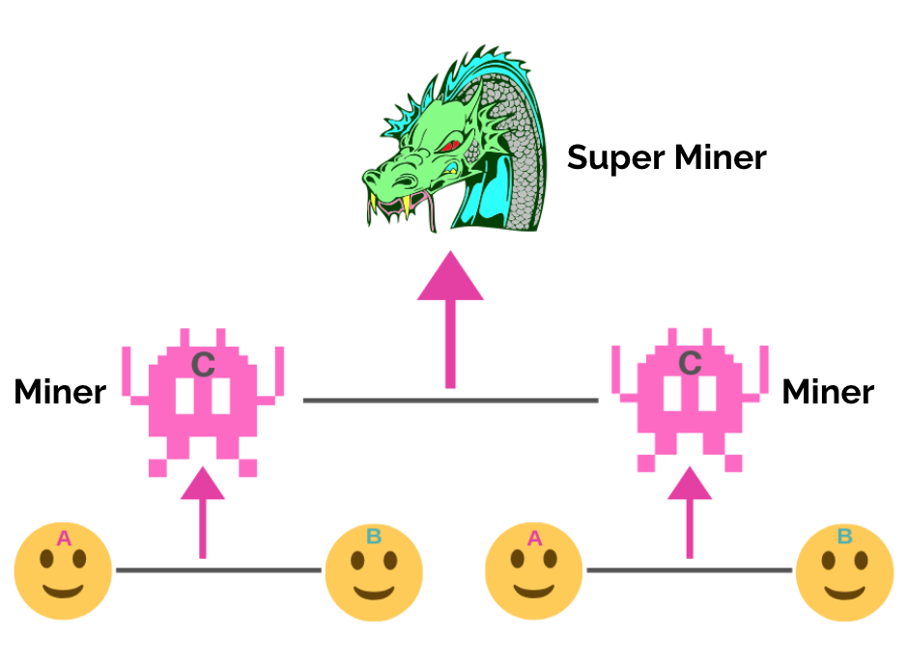

Slide 3
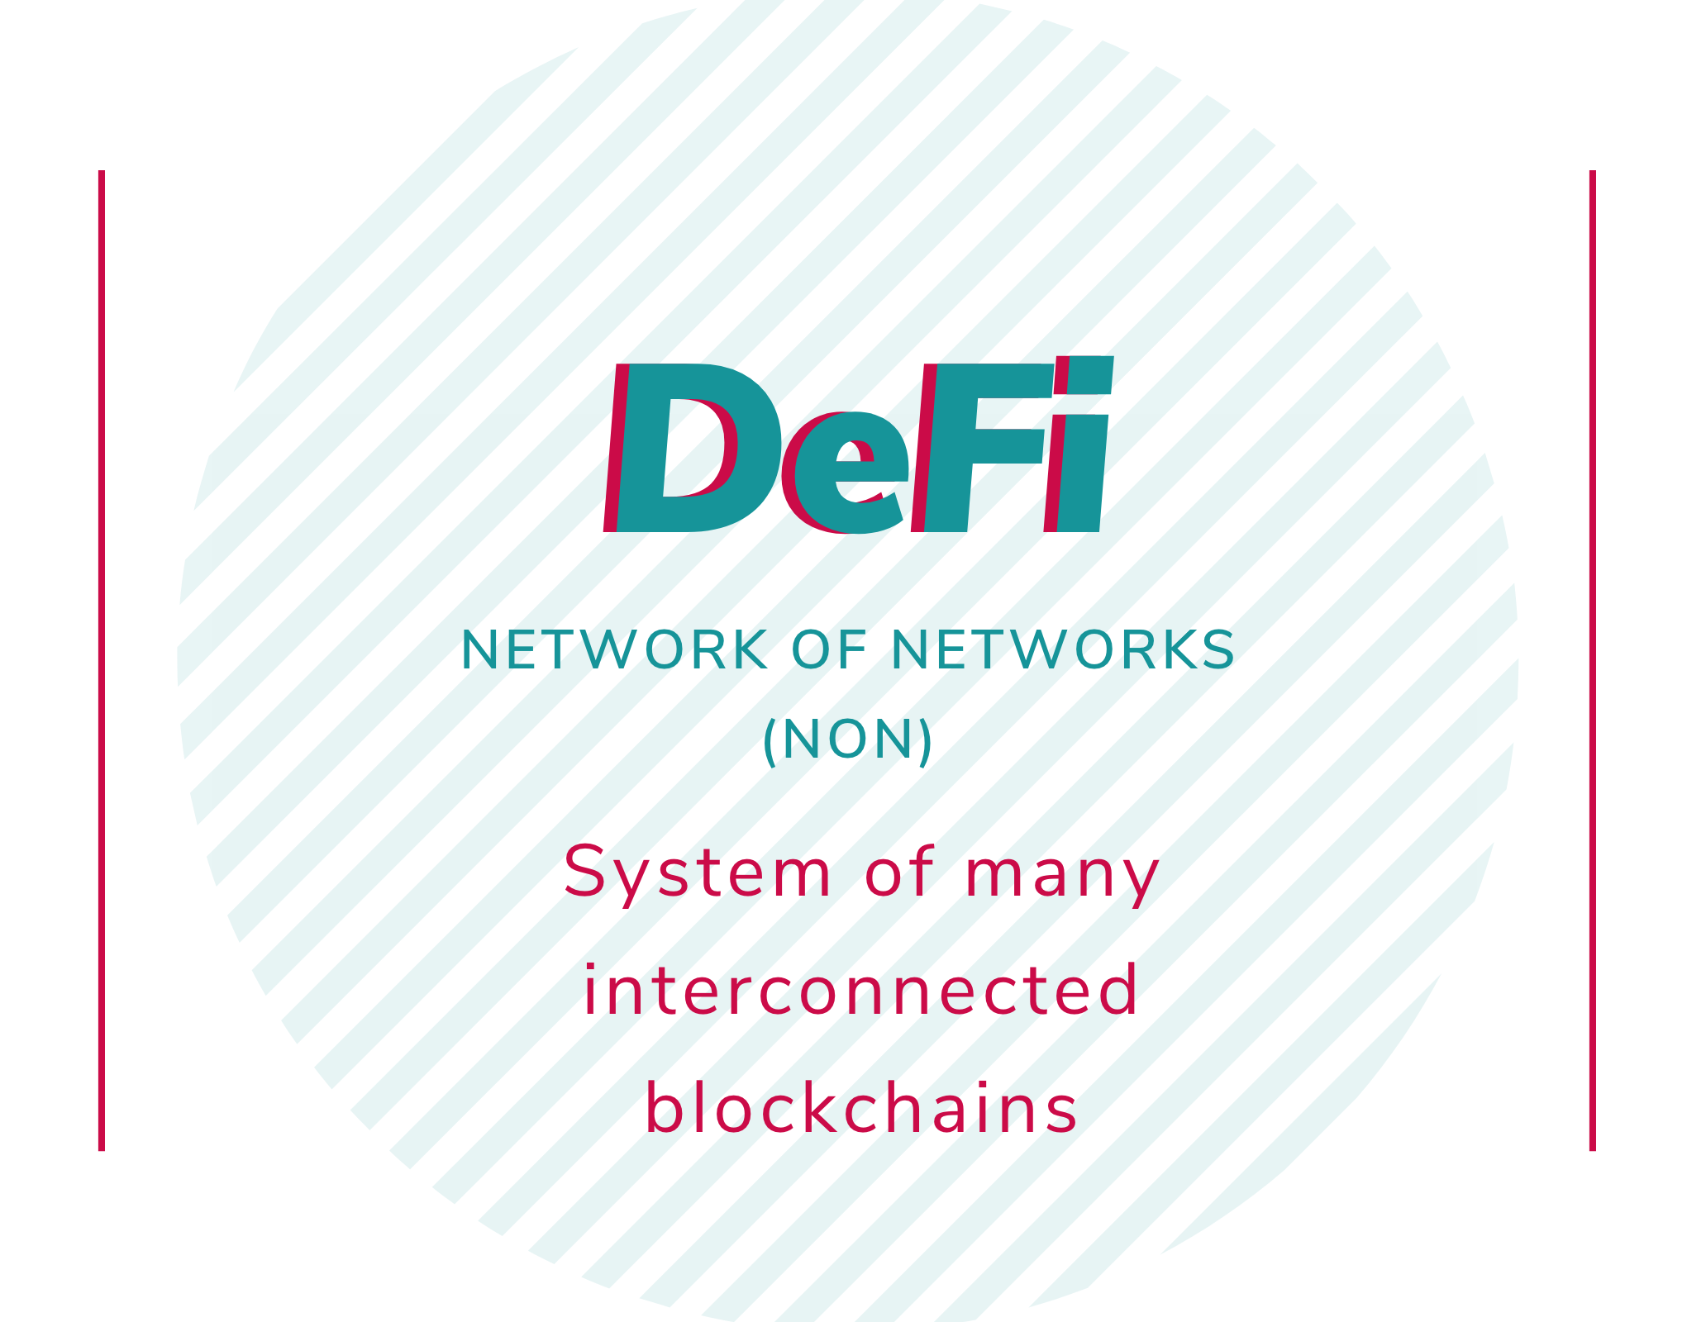
Shruti Appiah
Telegram: @shrutiappiah1
Notes:
Definition of defi.
Programmable money, but at the end of the day we’re really building a system of many interconnected, and sometimes interdependent networks. So I define Defi as a network of networks.

Slide 4
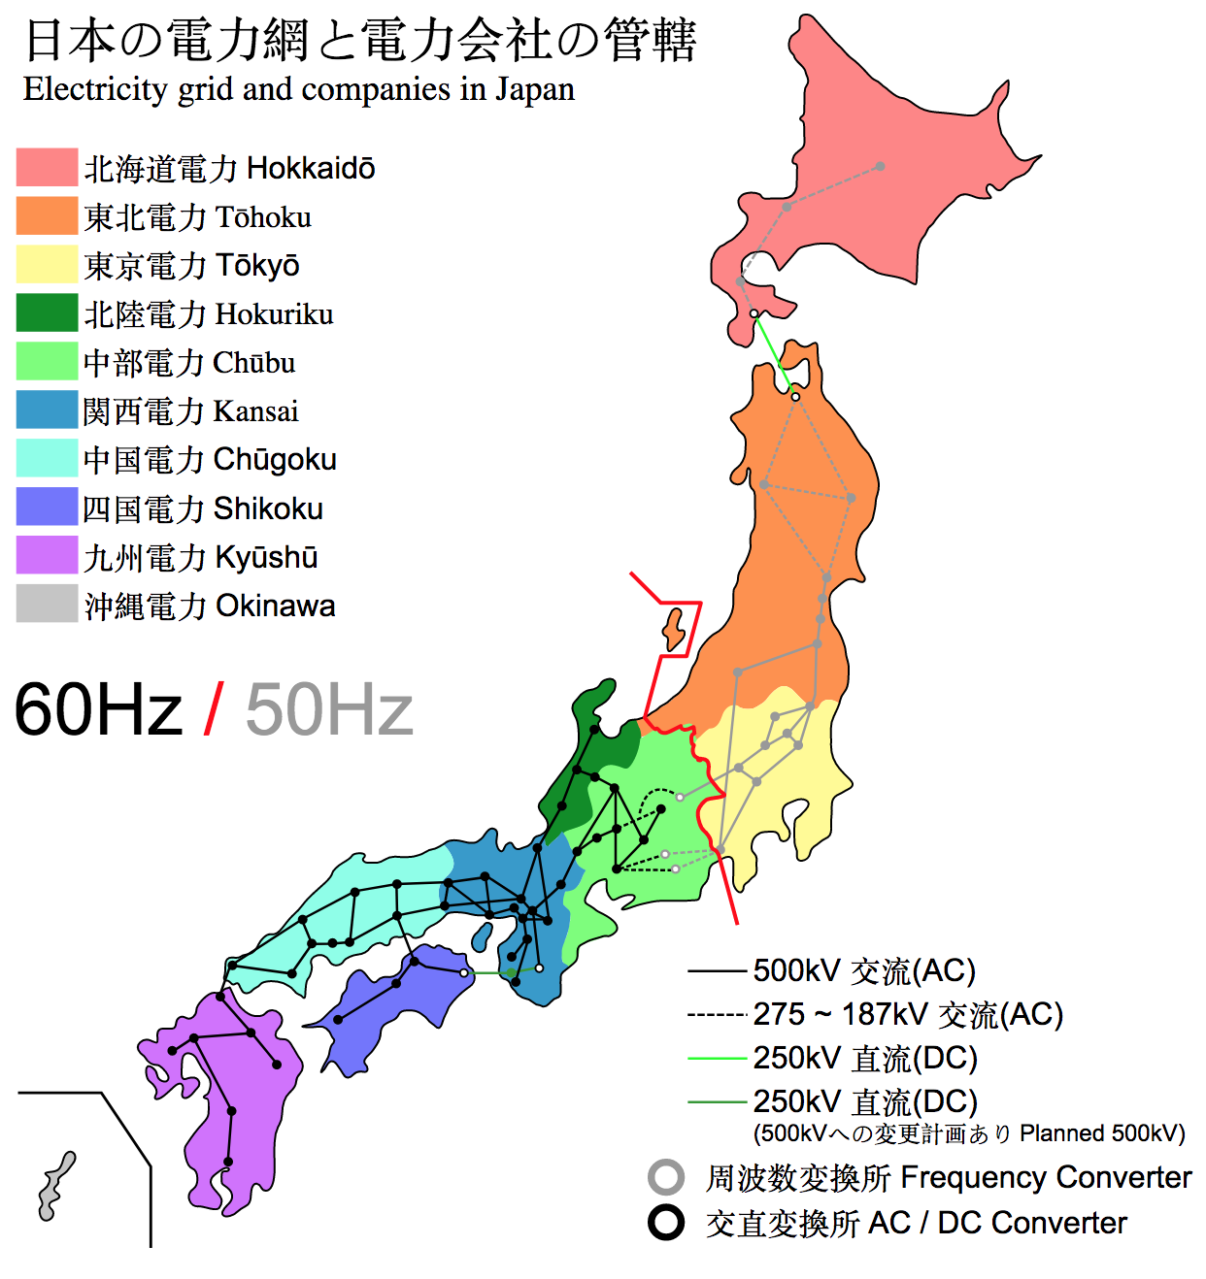
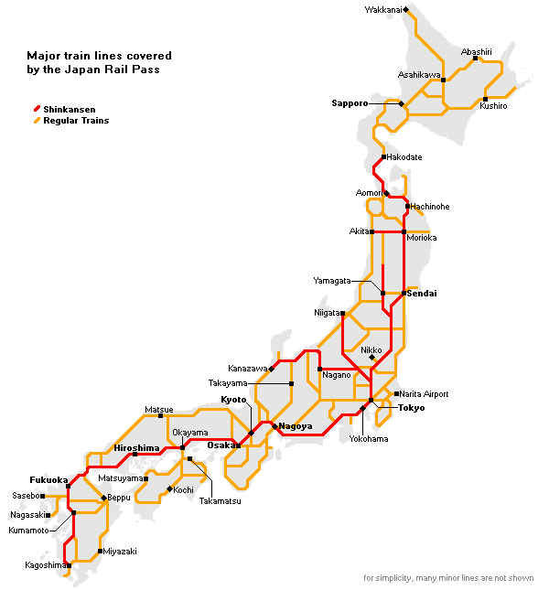
Japan rail network
Japan electricity network
Shruti Appiah
Telegram: @shrutiappiah1
Notes:
Japan rail network & electricity network are unidirectionally dependent.
Multi-plex
Consider there were no fail-safes, if the power transmission node in Kansai (highly central) failed, then the rail network wouldn’t be able

Slide 5
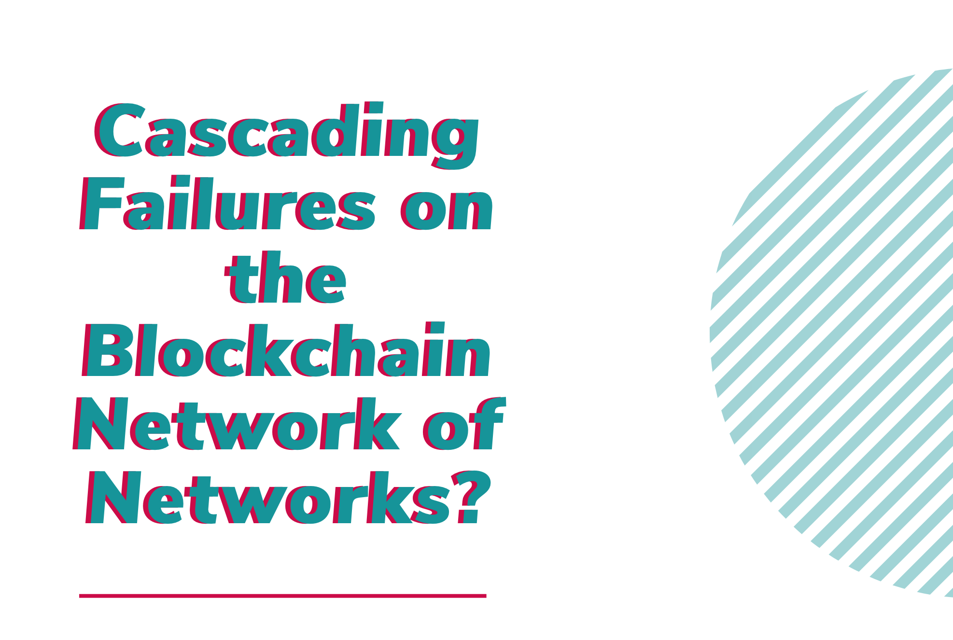
Shruti Appiah
Telegram: @shrutiappiah1

Slide 6
1
Approximate to generalized family of networks

Slide 7
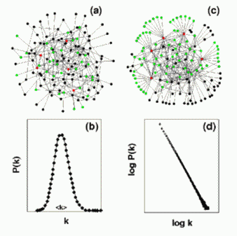
Erdős-Rényi
Random network
Albert-Barabási
Scale-free network
Shruti Appiah
Telegram: @shrutiappiah1
Notes:
Gaussian distribution
No. of nodes vs. degree on a log-log scale

Slide 8
2
Characterize single network

Slide 9
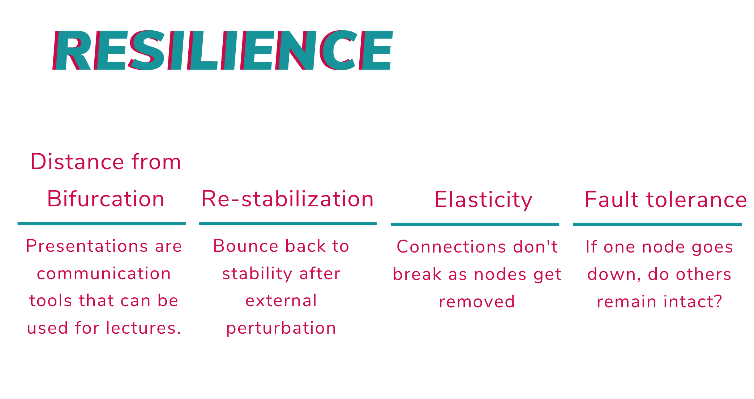
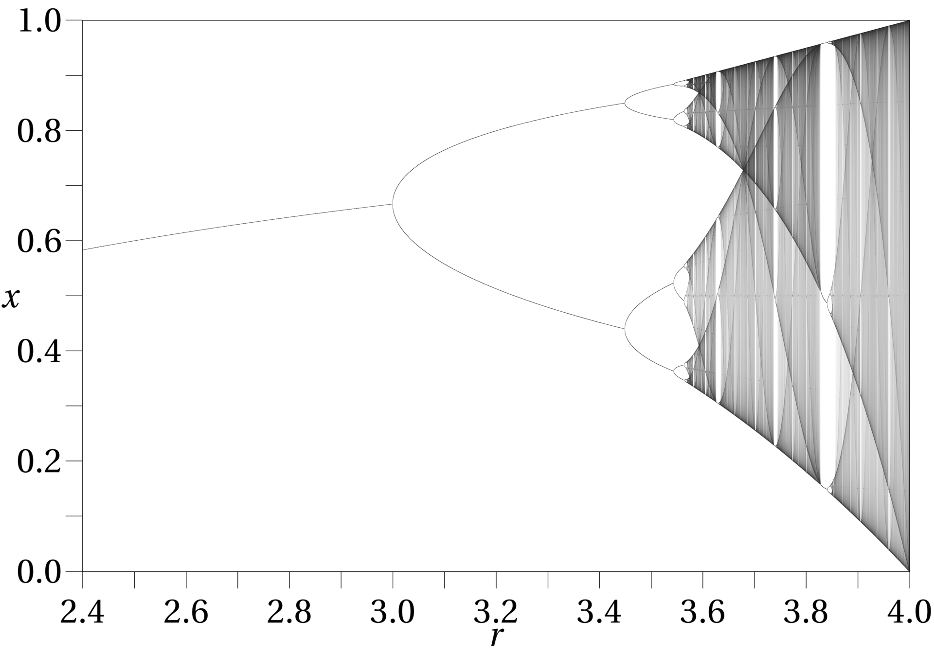
Shruti Appiah
Telegram: @shrutiappiah1
Notes:
Vary control parameter and suddenly, the system bifurcates.
Eg. of bifurcation - brain on psychoactive substances. Cyclical switches appear (hopf bifurcation)
Eg. of elasticity: Epidemic networks
Eg. of fault tolerance: low dependency network

Slide 10
3
Network of Networks

Slide 11
Network of Networks
Topology
Layers
Feedback
Direction of dependency
Structure of dependency
Shruti Appiah
Telegram: @shrutiappiah1

Slide 12
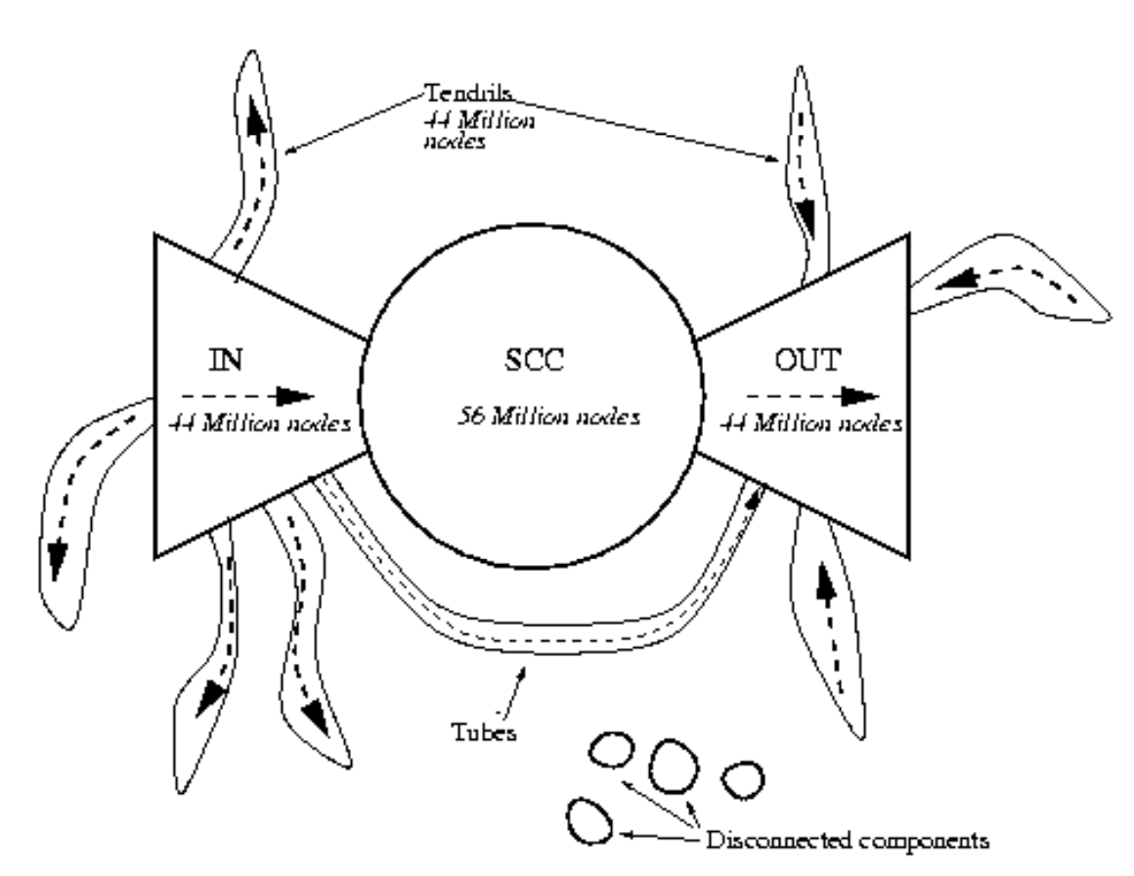
Topology
Bowtie
A. Broder et al. (2000)
Graph structure in the Web
Shruti Appiah
Telegram: @shrutiappiah1
Notes:
The Bow-Tie Structure of the Web
IN: Raw data - index of pages and links from one of the largest commercial search engines at the time, AltaVista
SCC: Giant strongly connected component. Many starting page websites that have links pointing to other similar websites. Undirected.
OUT: Pages that don’t link back to the SCC
Tendrils: Hanging off IN and OUT are TENDRILS containing nodes that are reachable from portions of IN, or that can reach portions of OUT, without passage through SCC.
A. Broder et al. (2000)
Graph structure in the Web

Slide 13
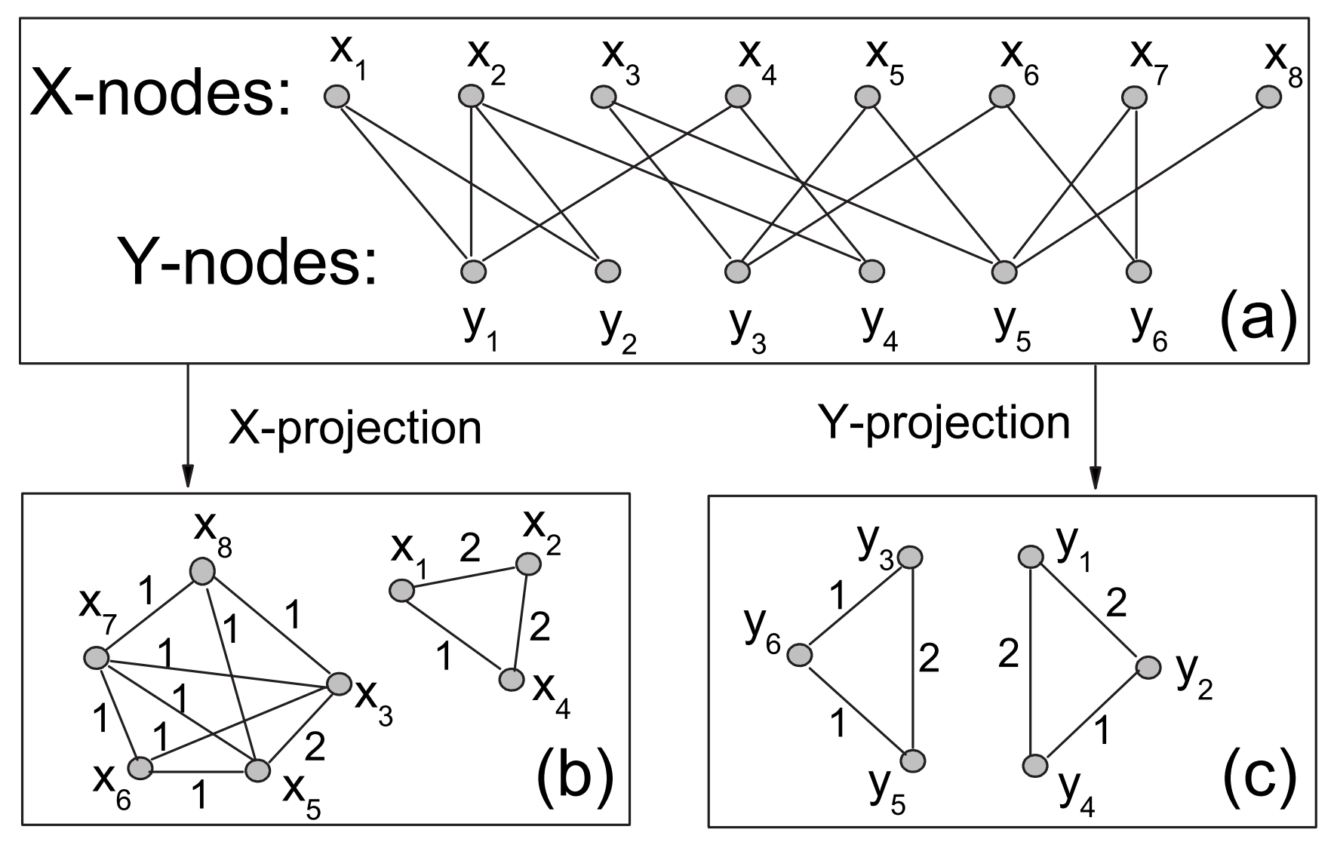
Topology
Bipartite
T. Zhou, et al. (2007)
Bipartite network projection and personal recommendation
Shruti Appiah
Telegram: @shrutiappiah1
Notes:
Connections can only run between nodes of network A to network B, not within network A or B.
T. Zhou, J. Ren, M. Medo and Y. Zhang (2007)
Bipartite network projection and personal recommendation

Slide 14
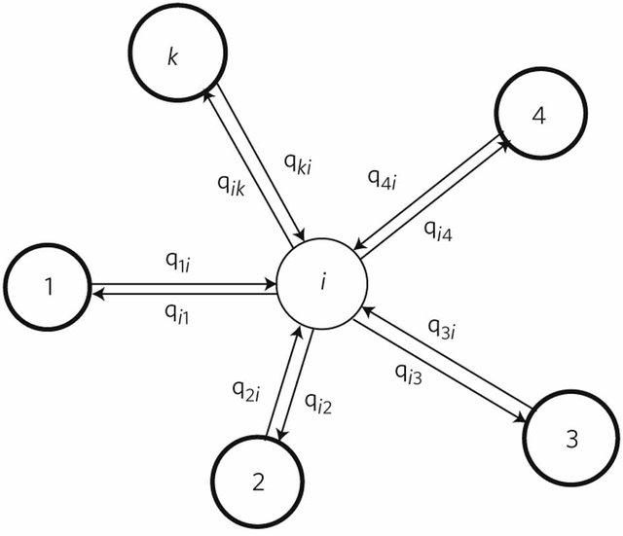
Topology
Hub & Spoke
J. Gao, et al. (2011)
Networks formed from interdependent networks
Shruti Appiah
Telegram: @shrutiappiah1
Notes:
J. Gao et al. (2011)
Networks formed from interdependent networks
Center network typically a SCC giant component
Peripheral networks are only dependent on central network, not on each other

Slide 15
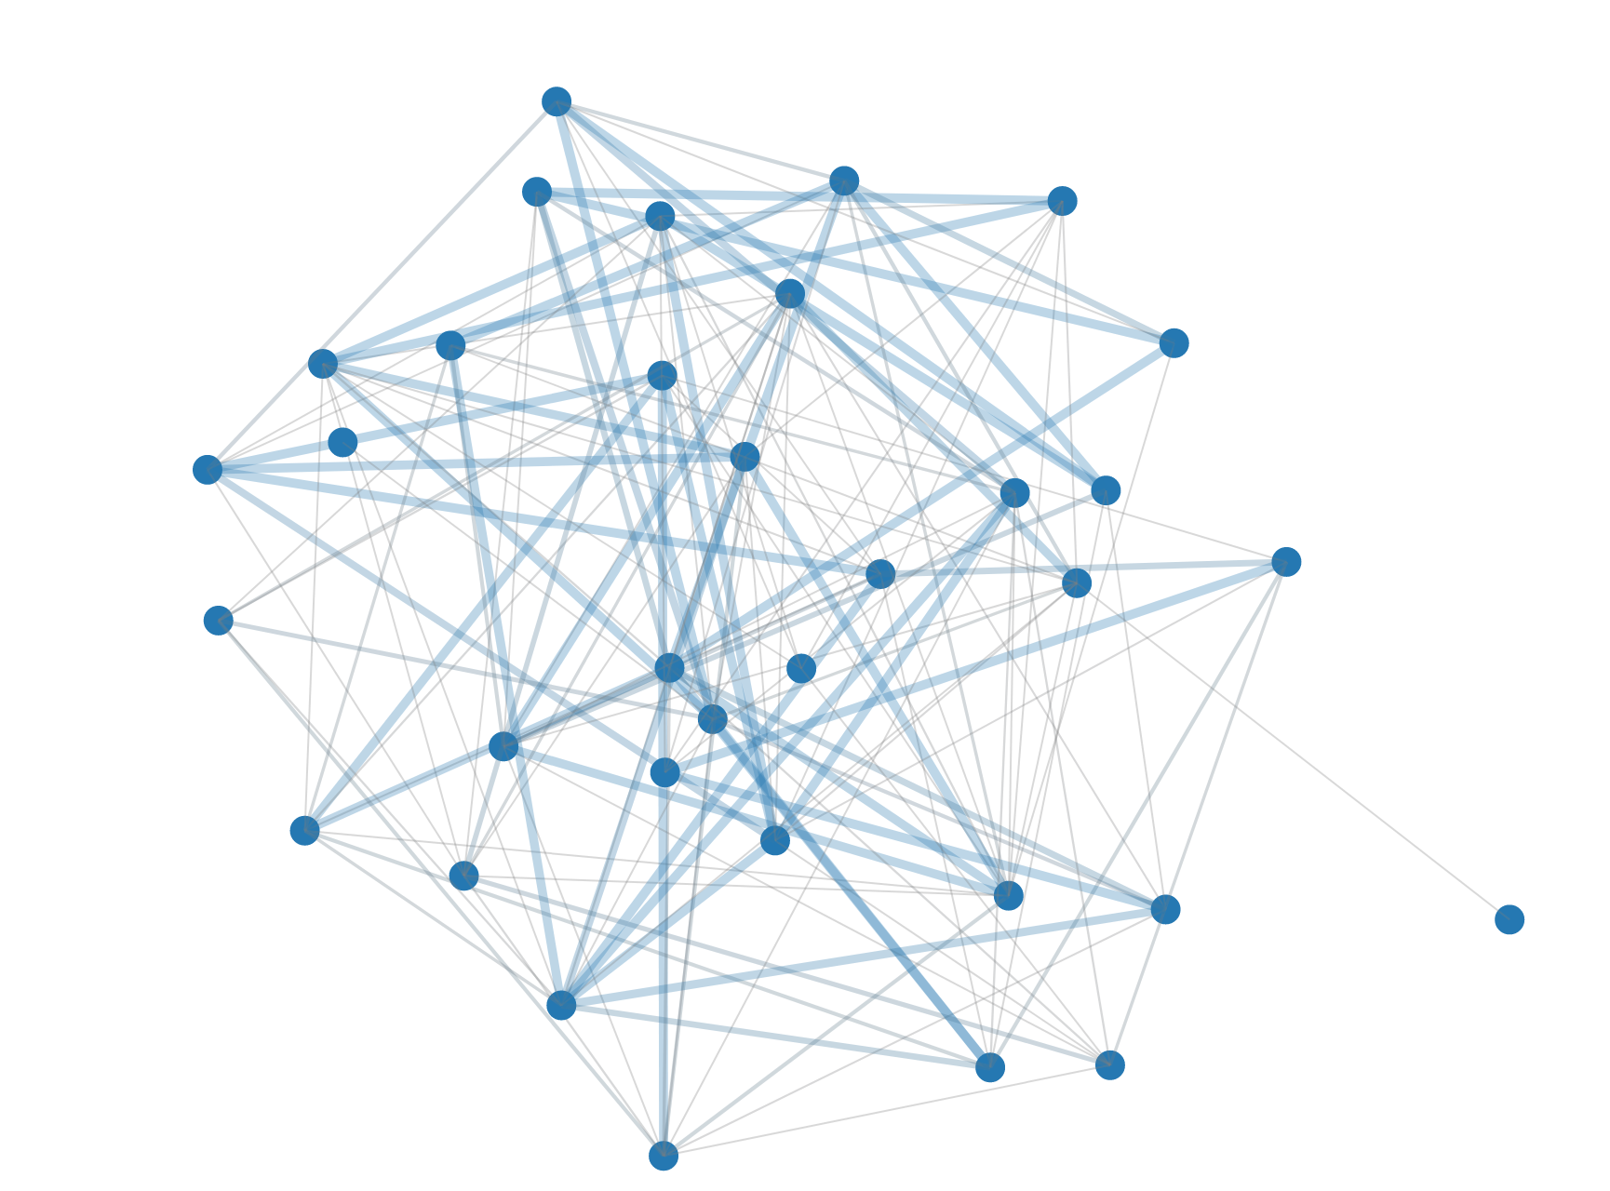
Layers
Single layer networks
Shruti Appiah
Telegram: @shrutiappiah1
Notes:
Spatial interdependence

Slide 16
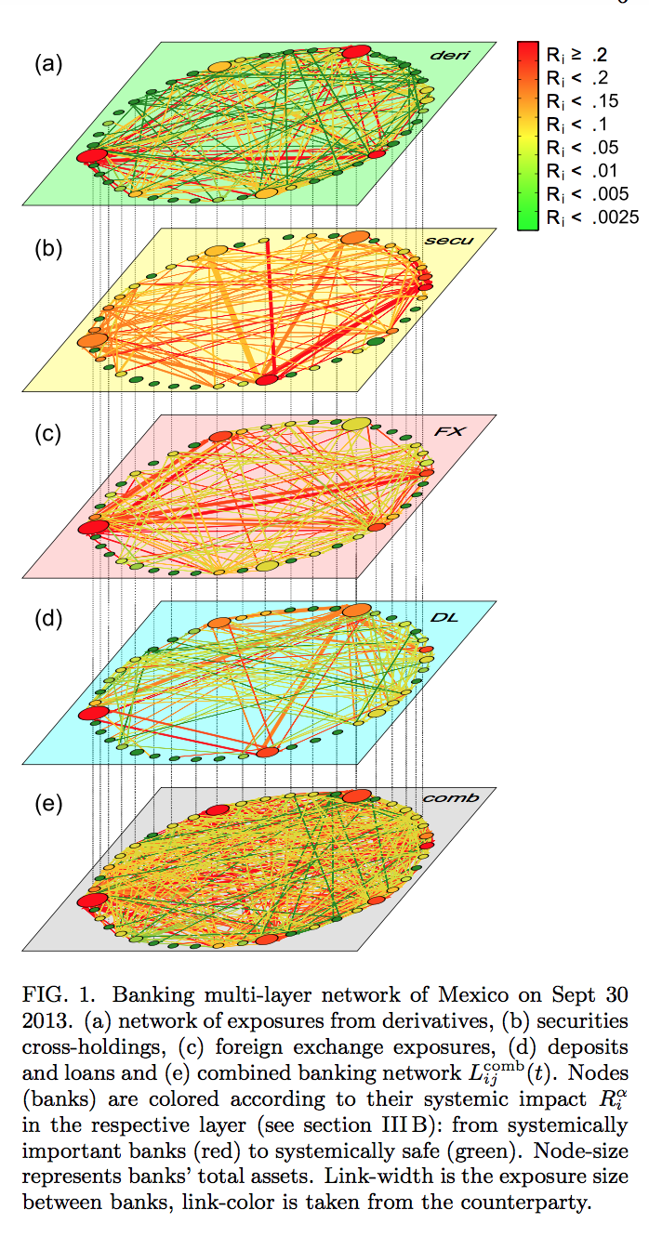
Layers
Multi-layered networks
S. Poldena et al. (2015)
The multi-layer network nature of systemic risk and its implications for the costs of financial crises
Shruti Appiah
Telegram: @shrutiappiah1
Notes:
S. Poldena et al. (2015)
The multi-layer network nature of systemic risk and its implications for the costs of financial crises
Links demonstrate exposure between banks

Slide 17
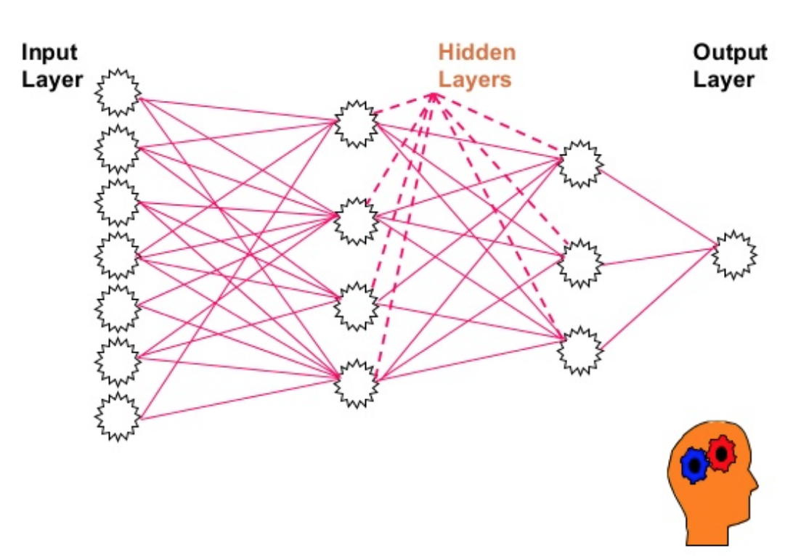
Feedback
Loopless
Feedforward neural networks
Shruti Appiah
Telegram: @shrutiappiah1
Notes:
Direction of data flow only forward

Slide 18
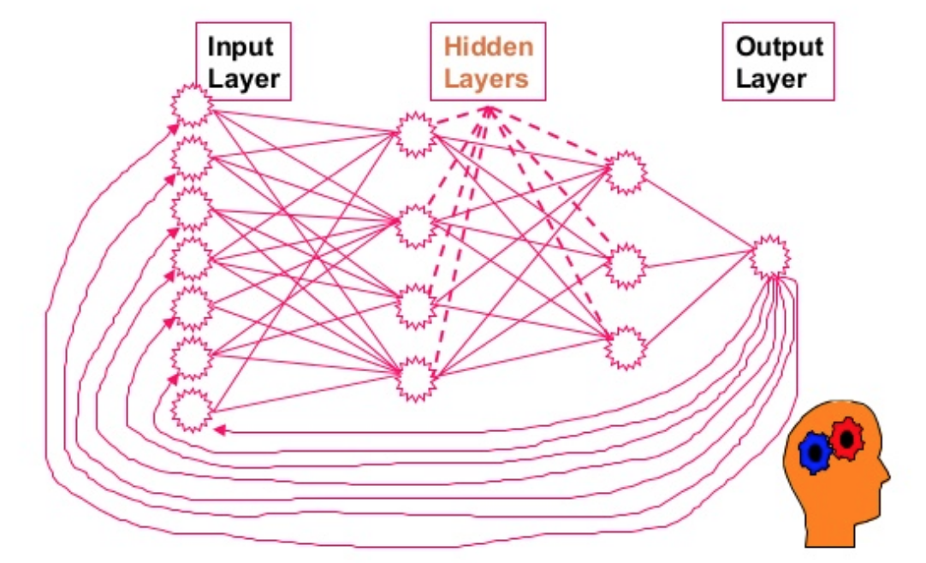
Feedback
Loopless
Recurrent neural networks
Shruti Appiah
Telegram: @shrutiappiah1

Slide 19
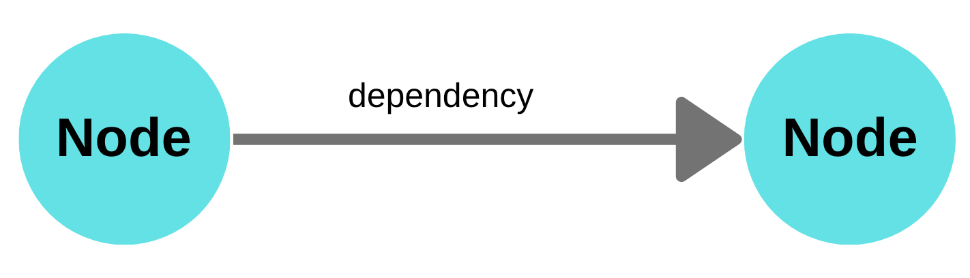
Direction of dependency
Unidirectional
Shruti Appiah
Telegram: @shrutiappiah1

Slide 20
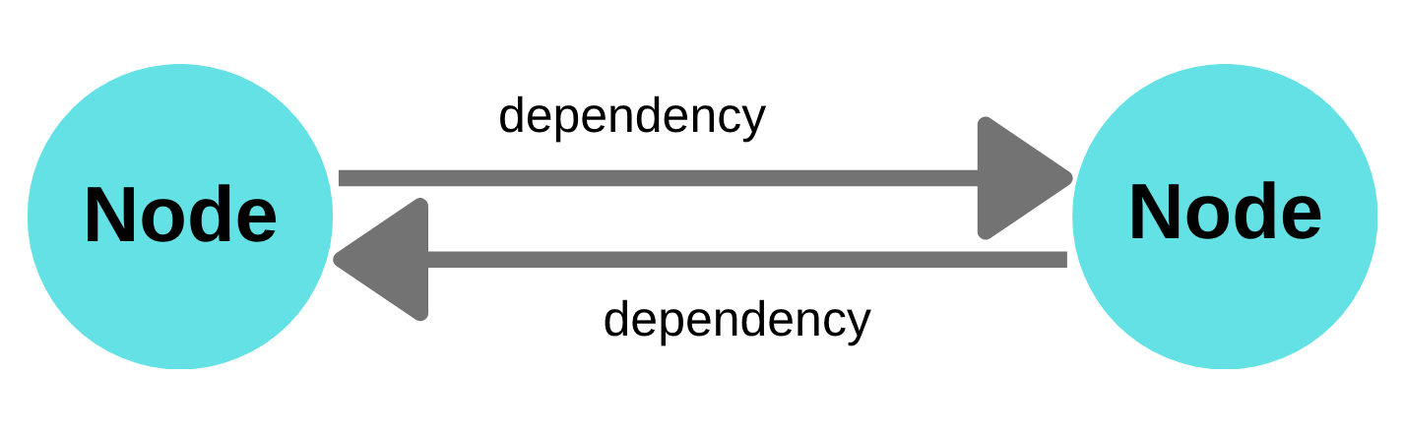
Direction of dependency
Bidirectional
Shruti Appiah
Telegram: @shrutiappiah1
Notes:
Quantity of risk is more here, but since both parties have skin in the game
Can pose sanctions on each other, thus bringing in some mechanism for accountability

Slide 21
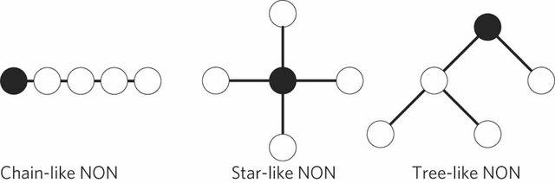
Structure of dependency
J. Gao, et al. (2011)
Networks formed from interdependent networks
Shruti Appiah
Telegram: @shrutiappiah1
Notes:
Three types of loopless NON composed of five coupled networks. The dark node represents the origin network on which failures initially occur.
Chain: Sequential failure propagation
Star: Failure explosion
Tree: Generational transfer of failure

Slide 22
4
Resilience in
Network of Networks

Slide 23
Error tolerance
How intact the diameter of the network stays when a small fraction
of nodes are removed
Random Networks
Low
Scale-free Networks
High
Shruti Appiah
Telegram: @shrutiappiah1
Notes:
Load transfer → Improves error tolerance

Slide 24
Network fragmentation
Clusters of nodes get separated from the main network as nodes are removed
Random Networks
High
Scale-free Networks
Low
Shruti Appiah
Telegram: @shrutiappiah1
Notes:
Redundancy → Improves attack survivability

Slide 25
Attack survivability
Informed agent deliberately tries to damage network by taking down highest degree nodes
Random Networks
High
Scale-free Networks
Low
Shruti Appiah
Telegram: @shrutiappiah1
Notes:
How to avoid cascading failures:
Load transfer → Improves error tolerance
Fail gracefully → Improves network fragmentation
Redundancy → Improves attack survivability

Slide 26
Time for some
Complex Networks
Simulations

Slide 27
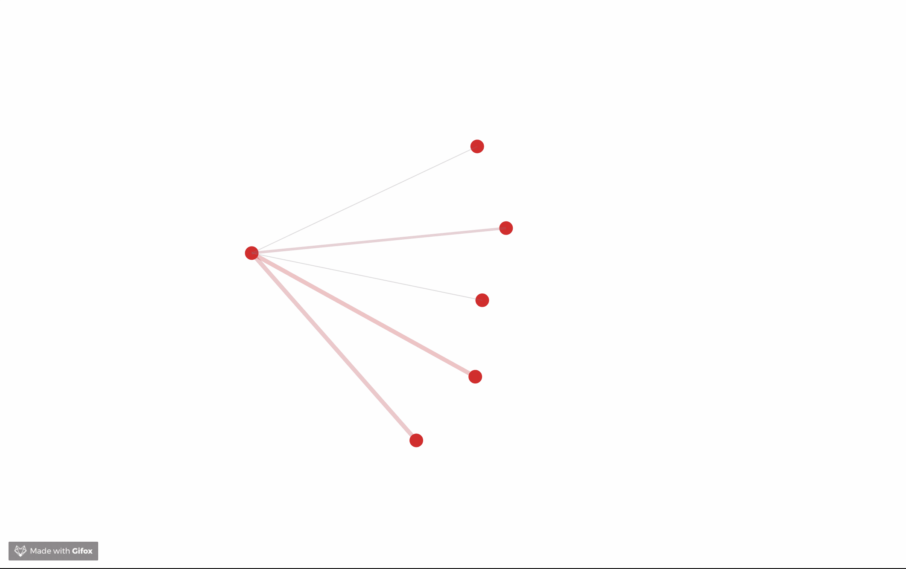
Shruti Appiah
Telegram: @shrutiappiah1
Notes:
Information spread in a complex network. Gossip protocol, same for epidemics/virus spreading.
Corrupt information can pass this way too.

Slide 28

Shruti Appiah
Telegram: @shrutiappiah1
Notes:
Formation of a scale free network

Slide 29
Research Questions
Directed interdependency graph of blockchain NoN
How will cascading failures manifest on a system of many blockchains?
What are the weak links and nodes?
What are the modes of failure?
How would you define resilience for a blockchain NoN?
How do you improve attack survivability for blockchain NoN?
NoN = Network of networks
Shruti Appiah
Telegram: @shrutiappiah1

Slide 30
Arigatō
Shruti Appiah
shruti.appiah@gmail.com
Telegram: @shrutiappiah1

Slide 31
APPENDIX

Slide 32
Step 2: Characterize a single network
Define resilience & robustness
Connectivity vs. dependency

Slide 33
Step 1: Approximate network of blockchains to a generalized family of networks that interdependent blockchain DeFi networks can be abstracted to
Erdos-Renyi network: Poisson distribution (random network)
Barabasi-Albert: Scale free, 80:20, power law distribution (preferential attachment)
Display unexpected degree of robustness. Error tolerant.
However, extremely vulnerable to attacks. Attack intolerant
R. Albert, H. Jeong, A.L. Barabási (2000)
Error and attack tolerance of complex networks
Notes:
https://arxiv.org/pdf/cond-mat/0008064.pdf
R. Albert, H. Jeong, A.L. Barabasi, Error and attack tolerance of complex networks, 2000

Slide 34
Resilience of a single network
Define resilience
Distance from bifurcation
Bounce back to stability after external perturbations
Self-stabilization from poorly configured initial conditions
Resilience to node removal
Elasticity (stretching two nodes apart doesn’t cause them to break) eg. epidemic networks
Speed of spread (of information, malicious code, downtime) across the network
Fault tolerance (if one node goes down, do the others remain intact?)

Slide 35
Step 3: Network of networks (NoN)
How are the networks connected?
Topology: Partial/full/single connection (bowtie)
Dimensions of dependency: Identify spatial vs temporal interdependencies
Layers: Single/Multi-layered
Feedback: Loopful/loopless
Direction of dependency: Uni/bidirectional
Network of networks structure: Chain/star/tree

Slide 36
Step 4: Resilience of network of networks
Error tolerance
How intact the diameter of the network stays when a small fraction of nodes are removed
Low for exponential networks and ER networks
High for scale-free networks
Notes:
https://arxiv.org/pdf/cond-mat/0008064.pdf
R. Albert, H. Jeong, A.L. Barabási (2000)
Error and attack tolerance of complex networks

Slide 37
Network fragmentation
Clusters of nodes get separated from the main network as nodes are removed
Low for scale-free networks (topologically stable). Remain intact despite nodes being isolated through random failures.
Quite high for exponential networks. They catastrophically fragment as nodes get isolated.

Slide 38
Attack survivability
Informed agent deliberately tries to damage network by taking down highest degree nodes
High for ER and exponential networks
Low for scale-free networks

Slide 39
Points of RISK
Where are the weak links?
Centralized exchanges
Custodians of large volumes of tokens
Highly relied on components
Eg. MakerDAO
Hacking attack on smart contracts
One of collateralized assets experiences a black swan
Competition takes over
Pricing errors, causing participants to lose confidence
Failure of centralized infrastructure aka Maker Foundation
Notes:
Vulnerability increases as coupling is introduced: https://arxiv.org/pdf/1012.0206.pdf
S. Havlin, N. A. M. Araujo (2010)
Catastrophic Cascade of Failures in Interdependent Networks

Slide 40
Research Questions
What will cascading failures on a networked system of many blockchains look like?
What are the weak links and nodes?
What are the modes of failure?
How would you define resilience for a blockchain network of networks?
How do you improve attack survivability for blockchain network of networks?

Slide 41
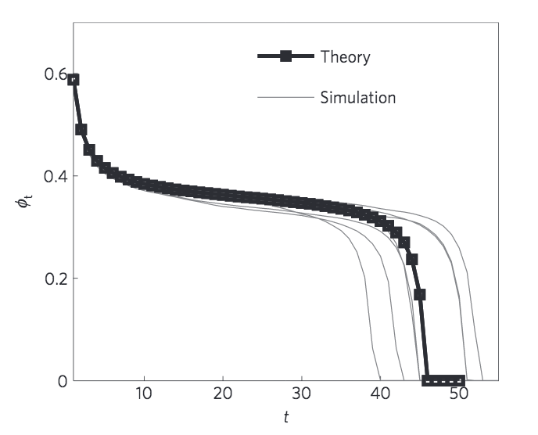
Theory vs. simulation
Cascading failures in two partially interdependent Erdos-Renyi networks
J. Gao, et al. (2011)
Networks formed from interdependent networks
Notes:
The grey lines represent different realizations. The squares represent the average over all realizations.

Slide 42
Research working groups
Complex Network of Networks
Road to under
collateralization
Resilience
&
Risk Mitigation
Propose a research topic!

Slide 43
References
https://arxiv.org/pdf/1603.07257.pdf
https://arxiv.org/pdf/1012.0206.pdf
Good one: https://www.researchgate.net/publication/253942636_Networks_formed_by_interdependent_networks
https://arxiv.org/pdf/cond-mat/0008064.pdf
https://link.springer.com/content/pdf/10.1007%2F978-3-319-20591-5_8.pdf
https://medium.com/coinmonks/defi-what-it-is-and-isnt-part-1-f7d7e7afee16

